Slide 1


NCAA Bracket Predictor Sprint 2
Nate Lang, John Hattas, Kevin Brosam, Alex Berkhout, Matt Petter

Slide 2
Sprint 3 Overview
Main Goal:
create working, hosted website
Create user interface

Slide 3
User Story Example
Alex wants to be able to easy access the predictor and run it. A website that has the predictor hosted would be the best option. He wants to be able to select the year and what indicator/indicators will be used. He also wants it to show the matchups and each winner and loser. He also wants to be able to easily run multiple predictions.

Slide 4
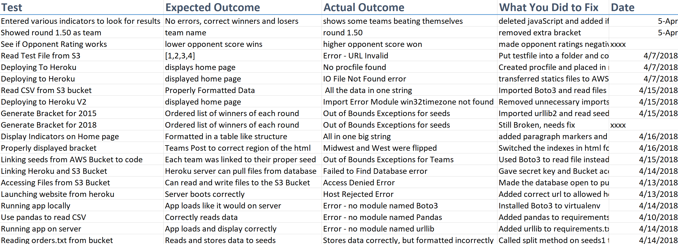
Tests

Slide 5

PRODUCT DEMO

Slide 6
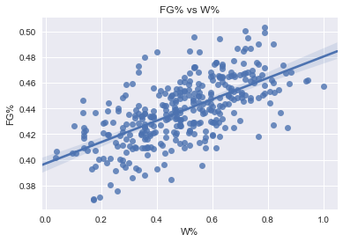
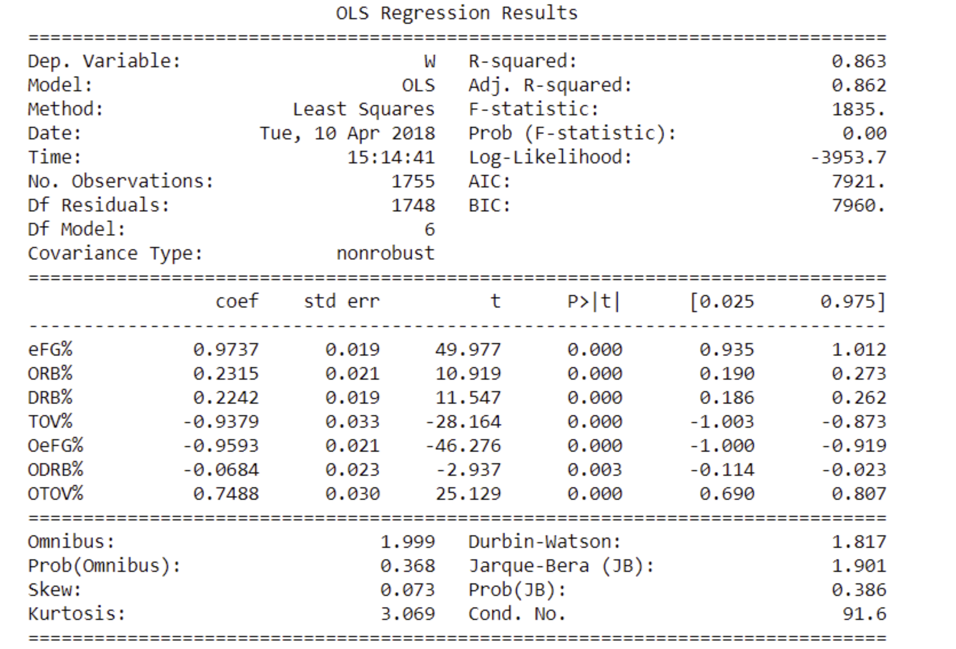
Statistical Methods

Slide 7
Backlogs
Sprint Backlog
Product Backlog
Task | Priority [1-10 (1 being lowest)] | Completed(Y/N)
Have Django code display a bracket depending on selected indicator | 6 | Y
Create graphs to give visual model | 9 | Y
Develop a statistical method for variable removal | 4 | Y
Have Django code able to select which year to use | 8 | Y
Have Django display what % of bracket is correct | 4 | N
Host website | 10 | Y
Have Django code display what possible indicators it can use | 7 | Y
Have Django code display the bracket and which teams it picked | 7 | Y
Develop a machine learning approach to find best possible bracket | 7 | N
Task | Priority [1-10 (1 being lowest)] | Completed(Y/N)
Develop an algorithm that predicts previous tournaments results | 1 | N
Integrate more advanced statistics | 7 | Y
Create picture of the bracket with appropriate teams | 7 | Y
Collect Data | 10 | Y
Have a basic working model | 10 | Y
Back test for better prediction results | 4 | N
Potentially display through HTML | 1 | Y
Update for 2018 tournament | 3 | Y
Compare different basic algorithms to find the easiest while not losing accuracy | 8 | N
Display data in charts and tables | 5 | Y
Add location as one of the indicator | 2 (if reasonably possible) | N
Create User Interface | 4 | Y

Slide 8
Sprint Retrospective
Successfully made website
Statistical analysis
Daily scrum, paired programming
Going forward…

